Slide 1
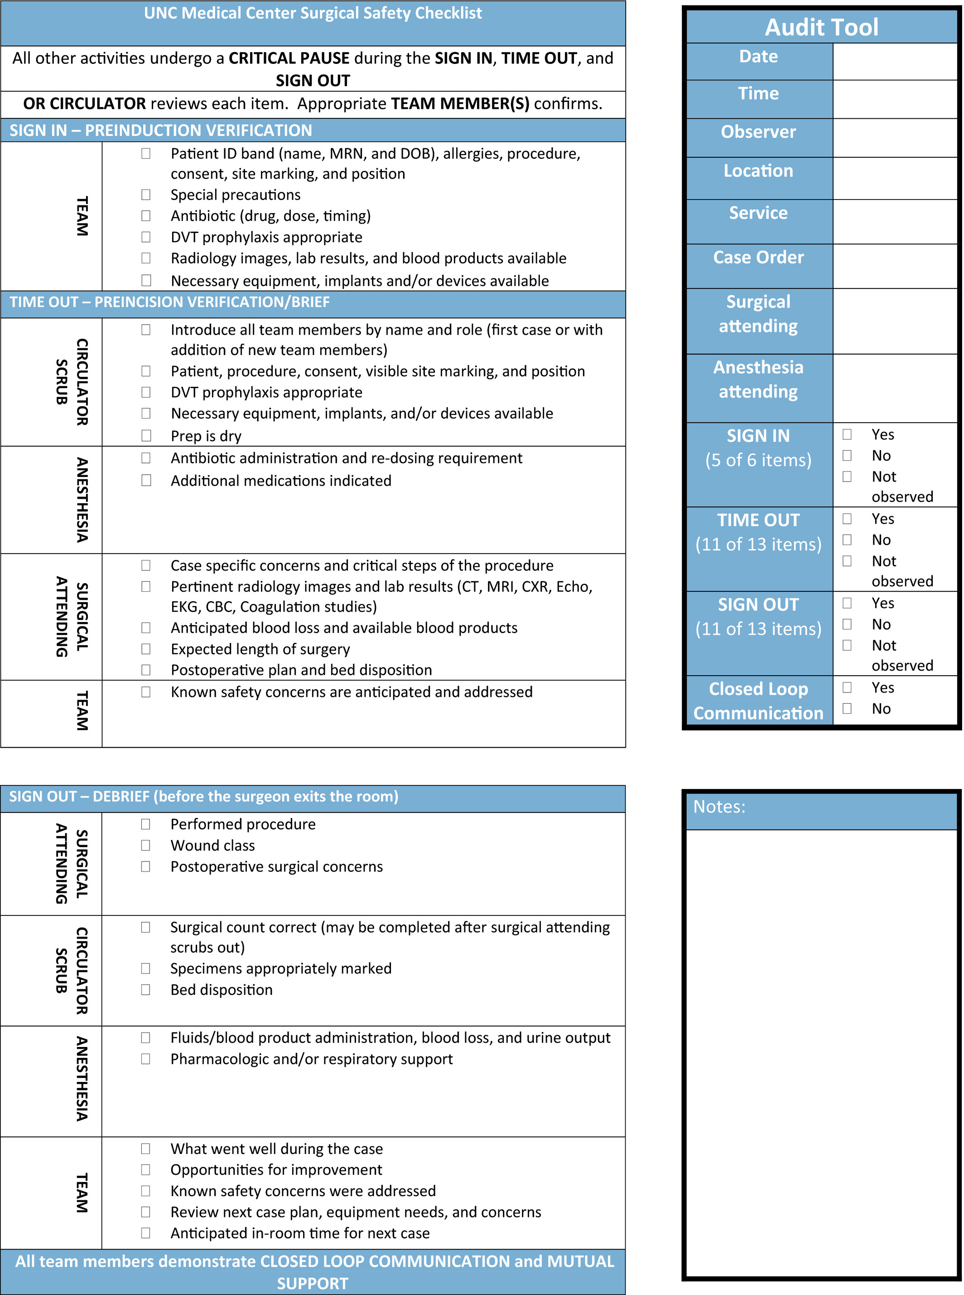
Debriefing in the OR: A Quality Improvement Project
AORN Journal, Volume: 109, Issue: 3, Pages: 336-344, First published: 27 February 2019, DOI: (10.1002/aorn.12616)
Notes:
University of North Carolina Medical Center's Surgical Safety Checklist audit tool. MRN = medical record number; DOB = date of birth; DVT = deep vein thrombosis; CT = computed tomography; MRI = magnetic resonance imaging, EKG = electrocardiogram; CBC = complete blood count. Based on the WHO Surgical Safety Checklist, http://www.who.int/patientsafety/safesurgery/checklist/en/index.html, © World Health Organization 2009. All rights reserved.
IF THIS IMAGE HAS BEEN PROVIDED BY OR IS OWNED BY A THIRD PARTY, AS INDICATED IN THE CAPTION LINE, THEN FURTHER PERMISSION MAY BE NEEDED BEFORE ANY FURTHER USE. PLEASE CONTACT WILEY'S PERMISSIONS DEPARTMENT ON PERMISSIONS@WILEY.COM OR USE THE RIGHTSLINK SERVICE BY CLICKING ON THE 'REQUEST PERMISSIONS' LINK ACCOMPANYING THIS ARTICLE. WILEY OR AUTHOR OWNED IMAGES MAY BE USED FOR NON-COMMERCIAL PURPOSES, SUBJECT TO PROPER CITATION OF THE ARTICLE, AUTHOR, AND PUBLISHER.

